Slide 1


Slide 2


Android Development

Slide 3

Course objectives
Android Development
By completing this course you will be able to:
  Develop user interfaces
  Develop activities

Slide 4

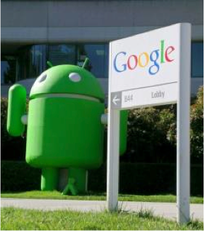
Course plan
Android Development
  Project
  Activities
  Logging
  Resources
  User Interfaces

Slide 5
PROJECT
Android Development

Slide 6

Project
General
An Android application is a loosely bound collection of activities, services, and other components
Before 2021 Packaged in an .apk file
  An archive of all components in the application
After 2021 Packaged in an aab file
  An dynamic archive of components
Described by a manifest
  Lists and configures the key application components
Notes:
[Title of the course]
Nov 8, 2008
Copyright © 2004-2005 NameOfTheOrganization. All rights reserved.
6

Slide 7
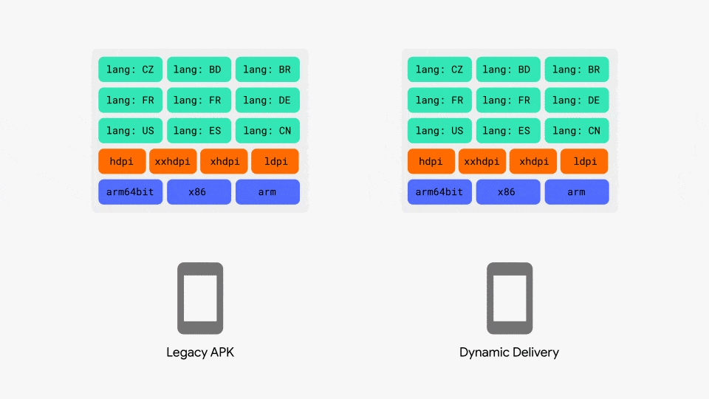
Project
General
APK vs AAB
Notes:
[Title of the course]
Nov 8, 2008
Copyright © 2004-2005 NameOfTheOrganization. All rights reserved.
7

Slide 8
Questions ?

Slide 9
Project
General
Every Android application must have a manifest
  AndroidManifest.xml
Provides a catalog of the application components
  Activities
  Services
  Security permissions
  Content providers
  Intents to respond to
  ...
Notes:
[Title of the course]
Nov 8, 2008
Copyright © 2004-2005 NameOfTheOrganization. All rights reserved.
9

Slide 10
Project
General
Every Android application must have a manifest
  AndroidManifest.xml
Provides a catalog of the application components
  Activities
  Services
  Security permissions
  Content providers
  Intents to respond to
  ...
Notes:
[Title of the course]
Nov 8, 2008
Copyright © 2004-2005 NameOfTheOrganization. All rights reserved.
10

Slide 11
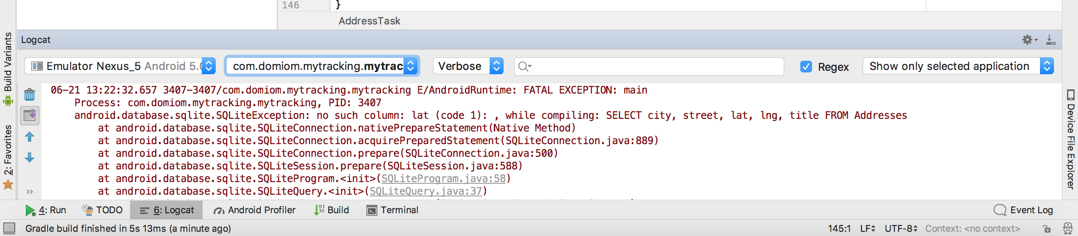
Project
General
Components can not be executed unless they are present in the manifest
If your new component does not work, check the manifest!
  Probably the biggest cause of “inexplicable” behavior in the development cycle
Notes:
[Title of the course]
Nov 8, 2008
Copyright © 2004-2005 NameOfTheOrganization. All rights reserved.
11

Slide 12
Project
General
New Android versions add major new features
  Applications commonly need to run on older devices
  Implemented using Android compatibility libraries
Android Studio projects automatically support backward compatibility
  Based on API versions selected
To support fragments and the action bar
  Compatibility library uses a sub-class of Activity – ActionBarActivity
Notes:
[Title of the course]
Nov 8, 2008
Copyright © 2004-2005 NameOfTheOrganization. All rights reserved.
12

Slide 13
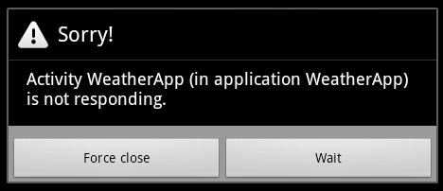
Project
System Responsive
Mobile devices are relatively limited
in performance
  CPU speeds kept low to improve battery life
Users want applications that function smoothly
Developers must focus on delivering responsive applications
  No long pauses while
    Waiting for a network or GPS position
    Searching databases, writing files, etc.
Notes:
[Title of the course]
Nov 8, 2008
Copyright © 2004-2005 NameOfTheOrganization. All rights reserved.
13

Slide 14
Project
System Responsive
A single resource-hogging application can slow everything down
  Android has a mechanism for detecting nonresponsive applications
  The dreaded Application Not Responding (ANR) error
To avoid ANRs
  Do not perform long tasks in the primary (user interface) thread
Android provides several mechanisms to run background tasks
  Services, AsyncTask, threads, and intents
Notes:
[Title of the course]
Nov 8, 2008
Copyright © 2004-2005 NameOfTheOrganization. All rights reserved.
14

Slide 15
Project
General
Android OS launches a Linux process for each application
  Assigns each application a unique Linux user ID
    Gives privileges to that user
  Launches each application in a separate Java VM
  This provides a “least privilege” environment
    Maximizes security
Applications are normally started by the user launching an activity
Notes:
[Title of the course]
Nov 8, 2008
Copyright © 2004-2005 NameOfTheOrganization. All rights reserved.
15

Slide 16

Project
Manifest
Mandatory file in every Android projects
Contain information needed by Android to run the application
  Package name of the application
  List of Activities, Services, Broadcast Receivers, …
  “Uses-permission” to access sensitive user data
  “Uses-feature” to declare hardware and software features your app needs
  Etc…
Notes:
[Title of the course]
Nov 8, 2008
Copyright © 2004-2005 NameOfTheOrganization. All rights reserved.
16

Slide 17
Project
Manifest
<manifest
xmlns:android="http://schemas.android.com/apk/res/android"
package="com.hesias.hellodroid” android:versionCode="1”
android:versionName="1.0”>
<application android:icon="@drawable/icon”
android:label="@string/app_name">
<activity android:name=".HelloDroid"
android:label="@string/app_name">
<intent-filter>
<action android:name="android.intent.action.MAIN" />
<category
android:name="android.intent.category.LAUNCHER" />
</intent-filter>
</activity>
</application>
<uses-permission android:name="android.permission.INTERNET" />
</manifest>
Notes:
[Title of the course]
Nov 8, 2008
Copyright © 2004-2005 NameOfTheOrganization. All rights reserved.
17

Slide 18
Activities
Android Development

Slide 19
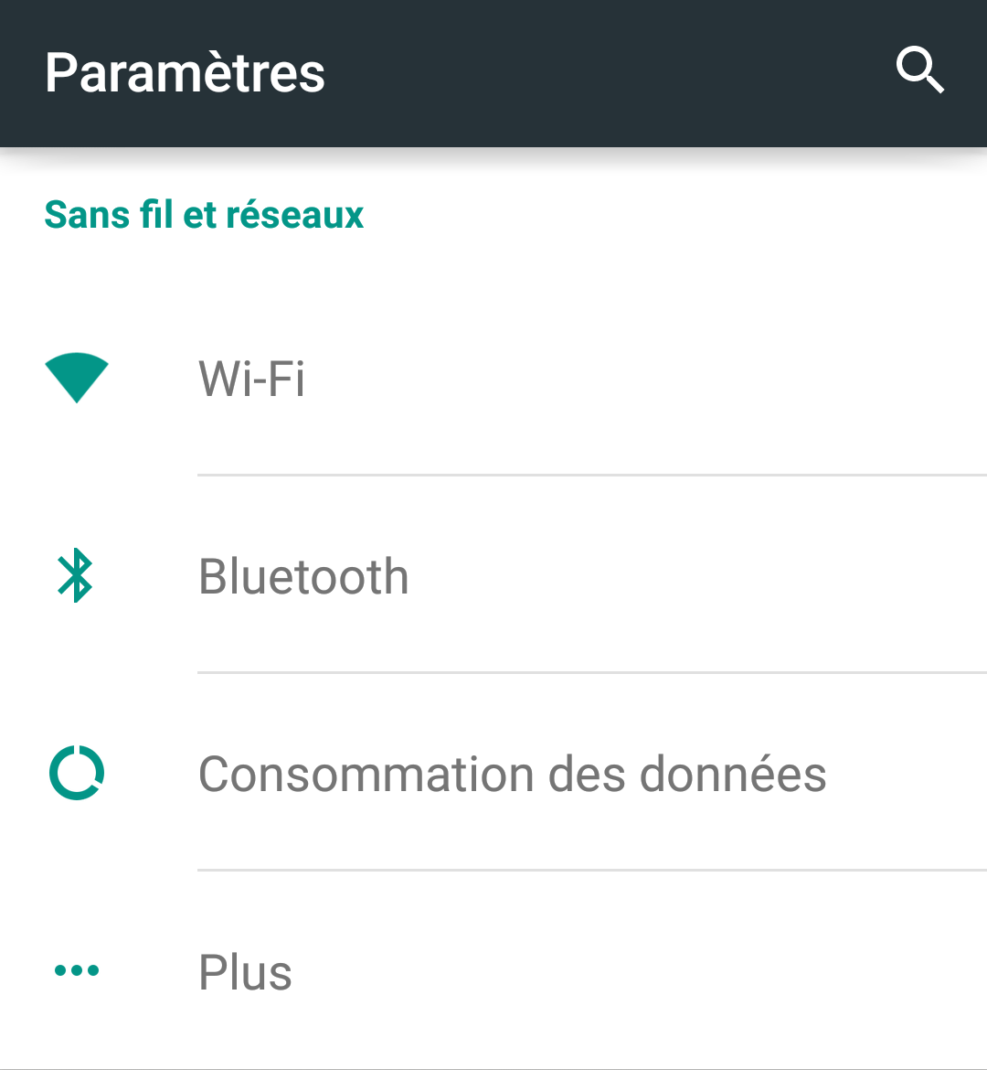
Activities
Presentation
An activity is a sort of screen composed of several views and controls :
  For instance an add contact form or a personalized Google Map
As many activities as application screens
Presentation layer of an application
Notes:
[Title of the course]
Nov 8, 2008
Copyright © 2004-2005 NameOfTheOrganization. All rights reserved.
19
Activities typically do more than just display static text
As ours has done so far!
Activities can do many things
Display lists
Provide forms for data entry
Provide interactive graphical screens, such as maps
Activities have
Code responsible for
Capturing user input
Supporting the activity life cycle
Interacting with underlying data and business logic
A view—what the user sees

Slide 20
Activities
Presentation
Composed of two parts :
  The Activity Logic :
    Define in Java inside a class extending android.app.Activity
  The User Interface :
    Define either in Java inside the Activity class or inside a XML file (in the folder /res/layout/)
Notes:
[Title of the course]
Nov 8, 2008
Copyright © 2004-2005 NameOfTheOrganization. All rights reserved.
20

Slide 21

Activities
Example
Activity class simple example :
package com.hesias.hellodroid;
import android.app.Activity;
import android.os.Bundle;
public class Main extends Activity {
/** Called when the activity is first created. */
@Override
public void onCreate(Bundle savedInstanceState) {
super.onCreate(savedInstanceState);
setContentView(R.layout.main);
}
}
Notes:
[Title of the course]
Nov 8, 2008
Copyright © 2004-2005 NameOfTheOrganization. All rights reserved.
21

Slide 22
Activities
Example
Layout file simple example :
<?xml version="1.0" encoding="utf-8"?>
<LinearLayout
xmlns:android=“http://schemas.android.com/apk/res/android”
android:orientation="vertical”
android:layout_width="match_parent"
android:layout_height="match_parent"
>
<TextView
android:layout_width="match_parent"
android:layout_height="wrap_content"
android:text="@string/hello”
/>
</LinearLayout>
Notes:
[Title of the course]
Nov 8, 2008
Copyright © 2004-2005 NameOfTheOrganization. All rights reserved.
22

Slide 23

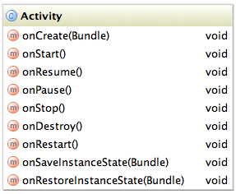
Activities
Life Cycle
An activity can have three states :
  Active
    The activity is visible and has the user focus
  Paused
    The activity is at least partly visible but doesn’t have the focus
  Stopped
    The activity is not visible
Activity class defines methods
to manage life cycle
Notes:
[Title of the course]
Nov 8, 2008
Copyright © 2004-2005 NameOfTheOrganization. All rights reserved.
23

Slide 24
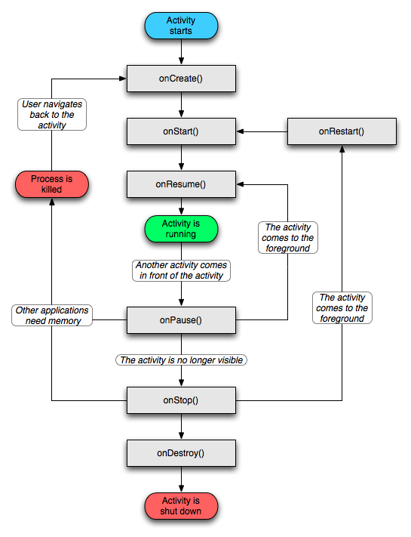
Activities
Life Cycle
Notes:
[Title of the course]
Nov 8, 2008
Copyright © 2004-2005 NameOfTheOrganization. All rights reserved.
24

Slide 25
Activities
Declare an Activity
To be usable, an activity must be declared
  Inside the AndroidManifest.xml file :
...
<application android:icon="@drawable/icon”
android:label="@string/app_name">
<activity android:name=".HelloDroid"
android:label="@string/app_name">
<intent-filter>
<action android:name="android.intent.action.MAIN" />
<category
android:name="android.intent.category.LAUNCHER" />
</intent-filter>
</activity>
<activity android:name=”.GoodByeDroid"
android:label="@string/app_name">
</activity>
</application>
...
Main Activity declaration
Activity declarations
Notes:
[Title of the course]
Nov 8, 2008
Copyright © 2004-2005 NameOfTheOrganization. All rights reserved.
25

Slide 26
LOGGING
Android Development

Slide 27
Logging
Presentation
Logging is an effective way of recording system behavior
  Significant events, errors, etc.
Android provides a built-in logging API
  Similar capabilities to Log4J
Android logs are held in device memory—not files
  LogCat (an SDK tool) displays logs during development
  Automatically displayed in the Android window of Android Studio
Notes:
[Title of the course]
Nov 8, 2008
Copyright © 2004-2005 NameOfTheOrganization. All rights reserved.
27

Slide 28
Logging
Presentation
Static methods provided on the android.util.Log class
  Log.v (verbose), Log.d (debug), Log.i (information)
  Log.w (warning), Log.e (error)
Logging methods share common signatures
  Log.w(String tag, String msg)
  Log.w(String tag, String msg, Throwable tr)
Notes:
[Title of the course]
Nov 8, 2008
Copyright © 2004-2005 NameOfTheOrganization. All rights reserved.
28

Slide 29
Logging
Presentation
Good practice is to define the log tag as a constant in the class
  private static final String TAG="IntentService";
  Use the name of the class as tag value
Add logging wherever needed during development
  But remember, there is a performance cost
Debug and verbose logging should always be stripped out of production applications
Log.i(TAG, "Something interesting happened");
Notes:
[Title of the course]
Nov 8, 2008
Copyright © 2004-2005 NameOfTheOrganization. All rights reserved.
29

Slide 30
Questions ?

Slide 31
Logging
Exercise (1/2)
Create a new Android Project named ActivityLifeCycle with :
  Application name : “Activity Life Cycle”
  Package name : “com.hesias.lifecycle”
  Activity name : “MainActivity”
Override the methods below :
  onCreate(Bundle)
  onStart()
  onResume()
  onPause()
  onStop()
  onDestroy()
Notes:
[Title of the course]
Nov 8, 2008
Copyright © 2004-2005 NameOfTheOrganization. All rights reserved.
31

Slide 32
Logging
Exercise (2/2)
In each method, add a log statement like this :
Where <method name> is the name of the method in which you are.
Deploy and run your application
Look at the Android Logcat
Play with emulator to see how the activity Life Cycle work.
  Display the DDMS perspective inside Eclipse
  Try to simulate an incoming call or SMS and look how your activity responds
Log.d(“LifeCycle”, <method name>);
Notes:
[Title of the course]
Nov 8, 2008
Copyright © 2004-2005 NameOfTheOrganization. All rights reserved.
32

Slide 33
Questions ?

Slide 34
Resources
Android Development

Slide 35
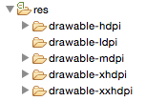
Resources
Presentation
Android externalize resources like :
  Images
  Strings
  User Interface description
  …
Easier to manage and maintain them
Contained inside the res folder
Notes:
[Title of the course]
Nov 8, 2008
Copyright © 2004-2005 NameOfTheOrganization. All rights reserved.
35

Slide 36
Resources
Presentation
Resource type | Path | Description
Drawables | res/drawable | Graphics and bitmaps
Layouts | res/layout | Layout files
Menus | res/menu | XML declarations of menus
Strings | res/values | XML declaration String
Styles | res/values | XML declaration of styles and themes
Notes:
[Title of the course]
Nov 8, 2008
Copyright © 2004-2005 NameOfTheOrganization. All rights reserved.
36

Slide 37
Resources
Use the resources
Resources are accessible inside the code thanks to the static class : R
  This class is automatically generated by ADT
  When you add a resource inside the res folder, ADT add a reference to it inside the R class
The syntax to retrieve a resource reference is :
R.resource_type.resource_name
Notes:
[Title of the course]
Nov 8, 2008
Copyright © 2004-2005 NameOfTheOrganization. All rights reserved.
37

Slide 38
Resources
Example
public final class R{
public static final class string {
public static final int app_name=0x7f020000;
}
public static final class layout {
public static final int my_screen=0x7f030000;
}
... //code omitted
}
// Define the layout of an activity
setContentView(R.layout.my_screen);
// Retrieve the application name
Resources resources = getResources();
String appName = resources.getString(R.string.app_name);
Notes:
[Title of the course]
Nov 8, 2008
Copyright © 2004-2005 NameOfTheOrganization. All rights reserved.
38

Slide 39
Resources
Use the resources
You can also use resources inside XML resources
Very used in layouts
Syntax :
Example :
“@[package_name:]resource_type/resource_identifier”
...
<TextView
android:layout_width="match_parent"
android:layout_height="wrap_content"
android:text="@string/hello”
/>
...
Notes:
[Title of the course]
Nov 8, 2008
Copyright © 2004-2005 NameOfTheOrganization. All rights reserved.
39

Slide 40
Resources
System Resources
Android already includes a number of resources
  Predefined Colors
  Predefined Strings
  Predefined Images
Examples :
String cancel =
resources.getString(android.R.string.cancel);
...
<TextView
android:layout_width="match_parent"
android:layout_height="wrap_content”
android:textColor="@android:color/darker_gray"
android:text="@string/hello”
/>
...
Notes:
[Title of the course]
Nov 8, 2008
Copyright © 2004-2005 NameOfTheOrganization. All rights reserved.
40

Slide 41
Resources
Simple values
Simple values are stored in XML files inside /res/values folder
You can declare
  Strings
    You can use the HTML tags <b>, <i> and <u>
  Colors
    Accept #RGB, #ARGB, #RRGGBB and #AARRGGBB format
  Dimensions
    In pixels (px), inches (in), millimeters (mm), points (pt), density-independent pixel (dp) or scale-independent pixel (sp)
  Arrays
    Of Integers or Strings.
Notes:
[Title of the course]
Nov 8, 2008
Copyright © 2004-2005 NameOfTheOrganization. All rights reserved.
41

Slide 42
Resources
Simple values
Example :
<?xml version="1.0" encoding="utf-8"?>
<resources>
<color name="Cyan">#00FFFF</color>
<string name="first_name">Brice</string>
<string-array name="my_array">
<item>A string</item>
<item>Another String</item>
</string-array>
<integer-array name="my_other_array">
<item>123</item>
<item>456</item>
</integer-array>
<dimen name="my_dimension">4dp</dimen>
<dimen name="text_size">4px</dimen>
</resources>
Notes:
[Title of the course]
Nov 8, 2008
Copyright © 2004-2005 NameOfTheOrganization. All rights reserved.
42

Slide 43
Resources
Images
Android accept different bitmap format for resources :
  PNG (advised by the documentation)
  JPEG
  GIF (deprecated)
From Android 1.6, three folders :
  drawable-hdpi : resource for high-resolution screens (240 DPI)
  drawable-mdpi : resources for medium-resolution screens (160 DPI)
  drawable-ldpi : resources for low-resolution screens (obsolete)
Android 4 or 5 accept high resolution:
  drawable-xxxhdpi : resource for very high-resolution screens (640 DPI)
  Drawable-xxhdpi : resources for very high-resolution screens (480 DPI)
  Drawable-xhdpi : resources for very high-resolution screens (320 DPI)
Notes:
[Title of the course]
Nov 8, 2008
Copyright © 2004-2005 NameOfTheOrganization. All rights reserved.
43
http://developer.android.com/design/style/iconography.html

Slide 44
Resources
Localizing
Not all Android users can or wish to use English!
  Resource structure makes localization process easy
Resource folder names may be extended with language and region codes
  Language code is defined by a two-letter ISO 639 code
  Region code is two-letter ISO 3166-1-alpha-2 preceded by an r
Default strings resources are defined in strings.xml
  Located in res/values
To support multiple languages
  Define strings for each language in a separate strings.xml file
  In a folder that identifies the locale
Res/resourceType-[language code]-[region code]
Notes:
[Title of the course]
Nov 8, 2008
Copyright © 2004-2005 NameOfTheOrganization. All rights reserved.
44
http://developer.android.com/design/style/iconography.html

Slide 45
Resources
Localizing
Example for French and Canada:
When searching for strings in the resource file, the search order is
  1 - Match language and region
  2 - Match language
  3 - Use the default
Locale | Path
Default | Res/values/strings.xml
French | Res/values-fr/strings.xml
French in Canada | Res/values-fr-rCA/strings.xml
Notes:
[Title of the course]
Nov 8, 2008
Copyright © 2004-2005 NameOfTheOrganization. All rights reserved.
45
http://developer.android.com/design/style/iconography.html

Slide 46
Questions ?

Slide 47
Resources
Exercise (1/3)
Create a new Android Project named GeekQuote with :
  Application name : “Geek Quote”
  Package name : “com.hesias.geekquote”
  Activity name : “QuoteListActivity”
Create a package “com.hesias.geekquote.models”
Create a JavaBean class named Quote inside it with :
  A string field named strQuote
  An int field named rating
  A date field named creationDate
Notes:
[Title of the course]
Nov 8, 2008
Copyright © 2004-2005 NameOfTheOrganization. All rights reserved.
47

Slide 48
Resources
Exercise (2/3)
Define an ArrayList field in your activity :
  It will contain all our quote objects
Add a String Array inside your strings.xml resource file
  Set a few quotes that we’ll use to initialize our list
Create a method in your activity class :
  void addQuote(String strQuote)
    It must convert the string received in parameter to Quote object and add it to your ArrayList
Notes:
[Title of the course]
Nov 8, 2008
Copyright © 2004-2005 NameOfTheOrganization. All rights reserved.
48

Slide 49
Resources
Exercise (3/3)
In onCreate(…) method
  Retrieve your string array resource
  Convert its content to Quote object and add them to your list
    Use the addQuote(…) method to do that
To see if it works you can use :
  The Debugger to explore your field content
  Loggers to display it in the LogCat
  Toast class to display it to the screen as a notification popup
Notes:
[Title of the course]
Nov 8, 2008
Copyright © 2004-2005 NameOfTheOrganization. All rights reserved.
49

Slide 50
User interfaces
Android Development

Slide 51
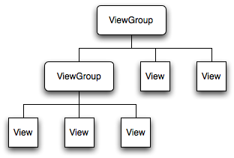
User Interfaces
Presentation
A user interface is a set of graphical components like :
  Button
  Text
  Form field
  Component composed of other components…
This components are called Views
The last one is a special view
called ViewGroup
Notes:
[Title of the course]
Nov 8, 2008
Copyright © 2004-2005 NameOfTheOrganization. All rights reserved.
51

Slide 52
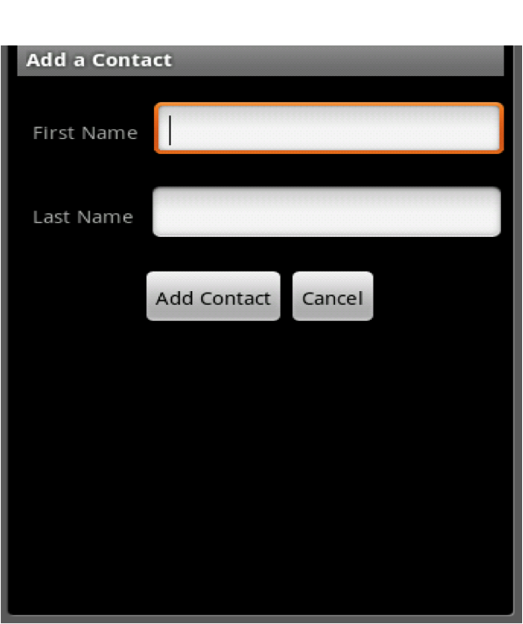
User Interfaces
Presentation
Views
ViewGroups
Notes:
[Title of the course]
Nov 8, 2008
Copyright © 2004-2005 NameOfTheOrganization. All rights reserved.
52

Slide 53
User Interfaces
Presentation
User interfaces can be defined :
  In XML, inside a layout resource file
  Directly in the Activity code
We’re going to see both
Notes:
[Title of the course]
Nov 8, 2008
Copyright © 2004-2005 NameOfTheOrganization. All rights reserved.
53

Slide 54

User Interfaces
XML Definition VS Java Definition
Use XML layout to define user interfaces is advised :
  Separate interface structure and interface logic
  Easier to maintain
But java definition can also be useful :
  Adding components dynamically
Notes:
[Title of the course]
Nov 8, 2008
Copyright © 2004-2005 NameOfTheOrganization. All rights reserved.
54

Slide 55
User Interfaces
XML Definition : Example
<?xml version="1.0" encoding="utf-8"?>
<LinearLayout
xmlns:android=“http://schemas.android.com/apk/res/android”
android:orientation="vertical”
android:layout_width="match_parent"
android:layout_height="match_parent"
>
<TextView
android:layout_width="wrap_content"
android:layout_height="wrap_content"
android:text="@string/first_name”
/>
<EditText
android:layout_width="wrap_content"
android:layout_height="wrap_content"
android:id="@+id/first_name”
/>
</LinearLayout>
Views
GroupView
Notes:
[Title of the course]
Nov 8, 2008
Copyright © 2004-2005 NameOfTheOrganization. All rights reserved.
55

Slide 56
User Interfaces
Java Definition : Example
public void onCreate(Bundle savedInstanceState) {
super.onCreate(savedInstanceState);
LinearLayout layout = new LinearLayout(this);
layout.setOrientation(LinearLayout.VERTICAL);
layout.setLayoutParams(
new LayoutParams(
LayoutParams.MATCH_PARENT,
LayoutParams.MATCH_PARENT));
TextView textView = new TextView(this);
textView.setText(R.string.first_name);
EditText editText = new EditText(this);
layout.addView(textView);
layout.addView(editText);
setContentView(layout);
}
Notes:
[Title of the course]
Nov 8, 2008
Copyright © 2004-2005 NameOfTheOrganization. All rights reserved.
56

Slide 57
User Interfaces
ID Attribute
Ids are typically assigned in the layout XML files, and are used to retrieve specific views inside the Activity code.
You can ask to ADT to generate one with the special syntax :
    Instead of :
“@+id/resource_identifier”
“@id/resource_identifier”
Notes:
[Title of the course]
Nov 8, 2008
Copyright © 2004-2005 NameOfTheOrganization. All rights reserved.
57

Slide 58
User Interfaces
ID Attribute
Example :
<EditText
android:layout_width="wrap_content"
android:layout_height="wrap_content"
android:id="@+id/first_name”
/>
EditText txtFirstName =
(EditText)findViewById(R.id.first_name);
Notes:
[Title of the course]
Nov 8, 2008
Copyright © 2004-2005 NameOfTheOrganization. All rights reserved.
58

Slide 59
Questions ?

Slide 60

The end
Thanks for your attention

